Slide 1
TaiESM and
TaiESM-TIMCOM Performance
Evaluation and Diagnostic Analysis
Earth System Modelling Homework I • Lalu Mantigi Wana Paksi

Slide 2


Introduction: TaiESM Model Overview
TaiESM Standalone
TaiESM-TIMCOM
Uses TIMCOM ocean data for model initialization and stability testing without observational validation
Integrated forcing data with full observational validation capability for realistic climate simulation
Stability Focus
Validation Focus
Key Distinction: TaiESM-TIMCOM represents a fully coupled ocean-atmosphere model that can be rigorously compared against observational datasets to evaluate simulation realism.
TaiESM Model Framework Analysis

Slide 3

Background: Climate Model Coupling
Ocean Component
Why Coupled Models Matter
TIMCOM provides ocean circulation, heat transport, and sea ice dynamics
•Capture feedbacks between ocean and atmosphere
•Simulate realistic climate variability (ENSO, PDO)
Atmosphere Component
•Enable long-term climate projections
Atmospheric dynamics, radiation, and precipitation processes
•Assess impacts of greenhouse gas forcing
Coupling Interface
Exchange of momentum, heat, and freshwater fluxes between components
Ocean-Atmosphere Coupling Framework

Slide 4

Research Motivation
Scientific Questions
How well does TaiESM-TIMCOM reproduce observed climate patterns, and what systematic biases limit its predictive capability?
Model Validation
Bias Identification
Physical Understanding
Compare simulated variables against observations to quantify model skill
Diagnose systematic errors in circulation, temperature, and precipitation
Identify mechanisms causing biases to guide development priorities
Importance: Understanding model biases is essential for improving projections used in policy decisions.
Foundation for Climate Model Development

Slide 5
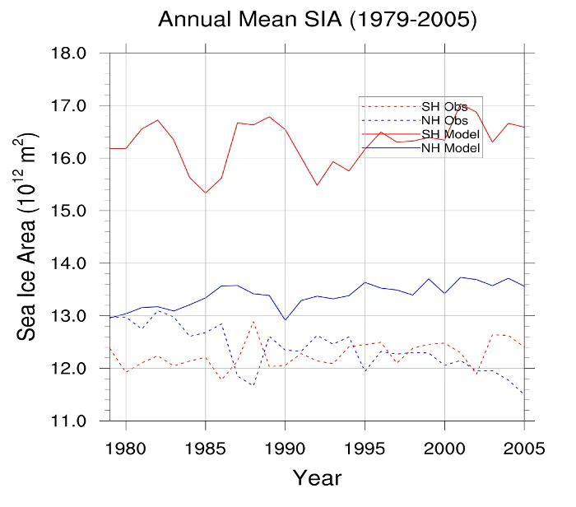
Sea Ice Area: Annual Mean Trends
Key Findings
NH: Model stable ~16.5×10¹² m² with realistic variability
SH: Critical bias - model stable while observations decline from ~13 to ~11.5
Southern Ocean warm bias prevents realistic sea ice decline
1979-2005 | Observations vs TaiESM

Slide 6
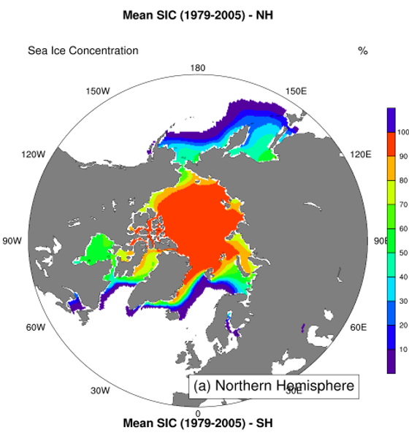
TaiESM: Sea Ice Concentration: Northern Hemisphere
Spatial Analysis
Central Arctic: Near-100% concentration captures perennial ice pack
Marginal Zones: Realistic gradients in Bering, Labrador Seas
Assessment: Excellent spatial skill validates Arctic simulation
Mean SIC (1979-2005)

Slide 7
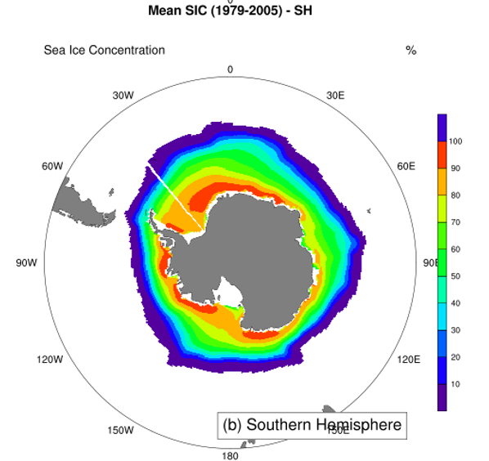
TaiESM: Sea Ice Concentration: Southern Hemisphere
Circumpolar Ice
Inner Ring: 90-100% concentration near Antarctica
Outer Edge: Sharp gradient at ~60°S marks ACC boundary
Challenge: Warm bias inhibits realistic ice expansion
Mean SIC (1979-2005)

Slide 8
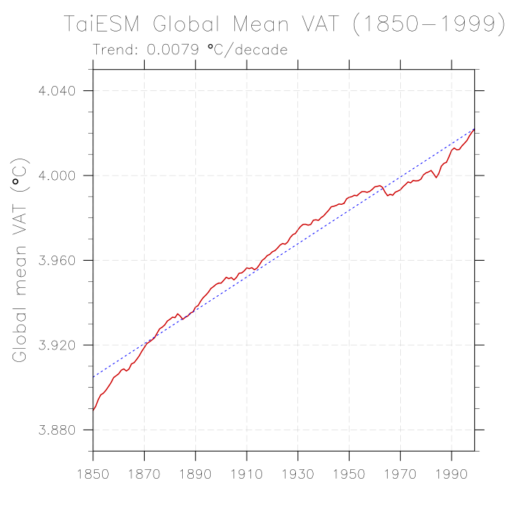
Ocean Heat Content: Volume-Averaged Temperature
Smooth Warming
Trend: 0.0079°C/decade from 3.880°C to 4.040°C
Smooth curve reflects ocean thermal inertia damping variability
Significance: VAT tracks 90% of climate warming stored in oceans
Global Mean VAT (1850-1999)

Slide 9
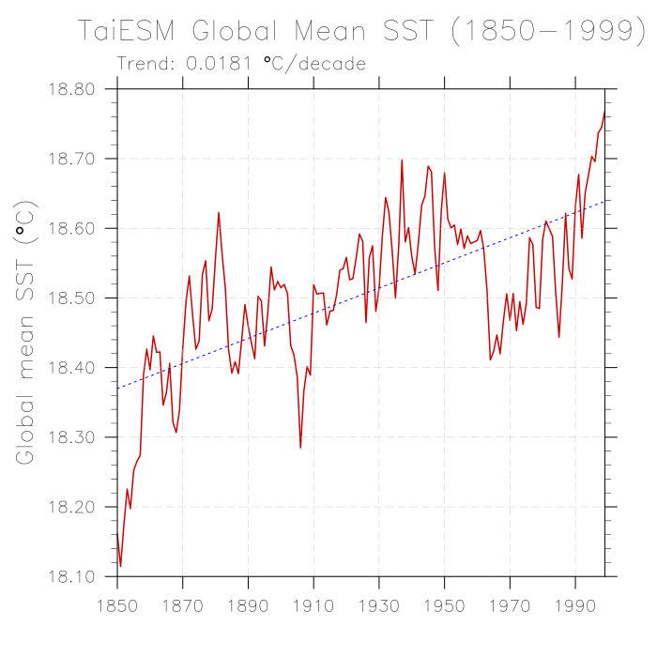
Sea Surface Temperature: Time Series
High-Frequency Variability
Trend: 0.018°C/decade - 18.10°C to 18.75°C
Sharp peaks reflect El Niño events releasing ocean heat
Note: SST shows 2x faster warming than VAT
Global Mean SST (1850-1999)

Slide 10
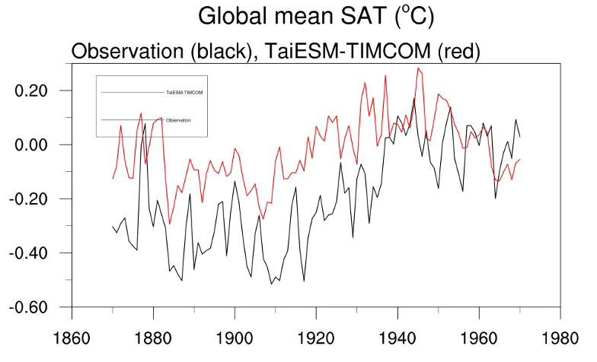
Surface Air Temperature: Model vs Observations
Model Assessment
Pre-1950: ~0.3°C warm bias indicates aerosol underestimation
Post-1950: Excellent agreement validates climate sensitivity
Confidence: Post-1950 skill supports future projections
SAT Anomaly (1860-1980) | Black: obs; Red: model

Slide 11
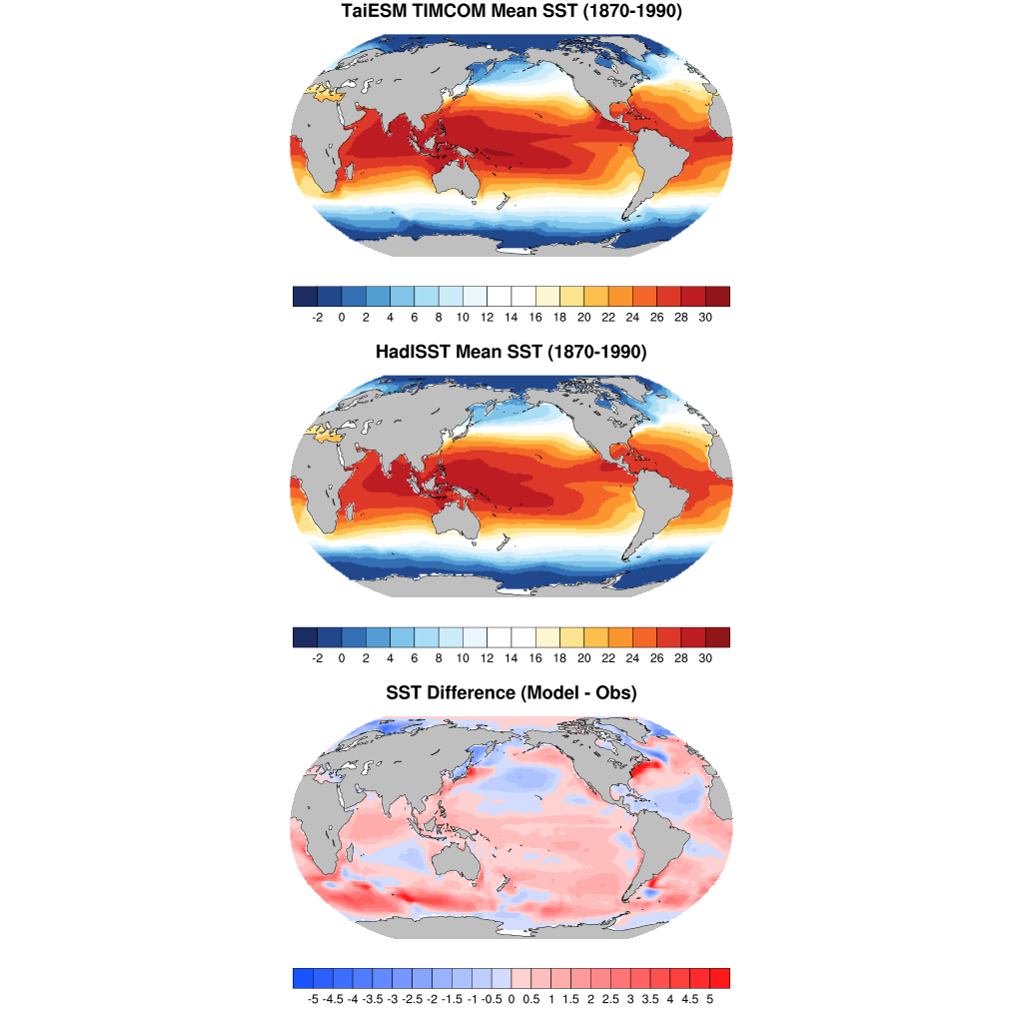
SST Spatial Patterns & Critical Biases
Four Major Biases
1. Southern Ocean +3-5°C: Insufficient clouds, weak ACC
2. North Atlantic -2-4°C: Weak AMOC reduces heat transport
3. Coastal Upwelling +1-3°C: Coarse resolution issue
4. Equatorial Cold Tongue: Excessive upwelling affects ENSO

Slide 12
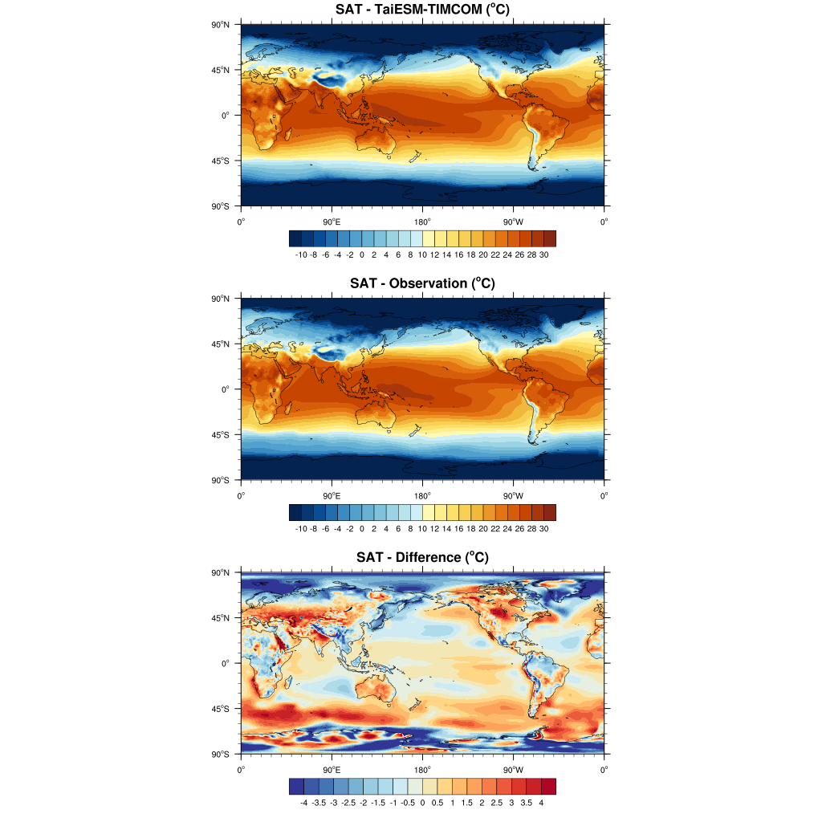
Surface Air Temperature: Spatial Distribution
Bias Patterns
Excellent Pattern: Similar tropical warmth, polar cooling
Southern Ocean: Red band shows +3-5°C bias
Insight: SAT biases mirror SST, confirming coupling fidelity
Top: Model | Middle: Obs | Bottom: Difference

Slide 13
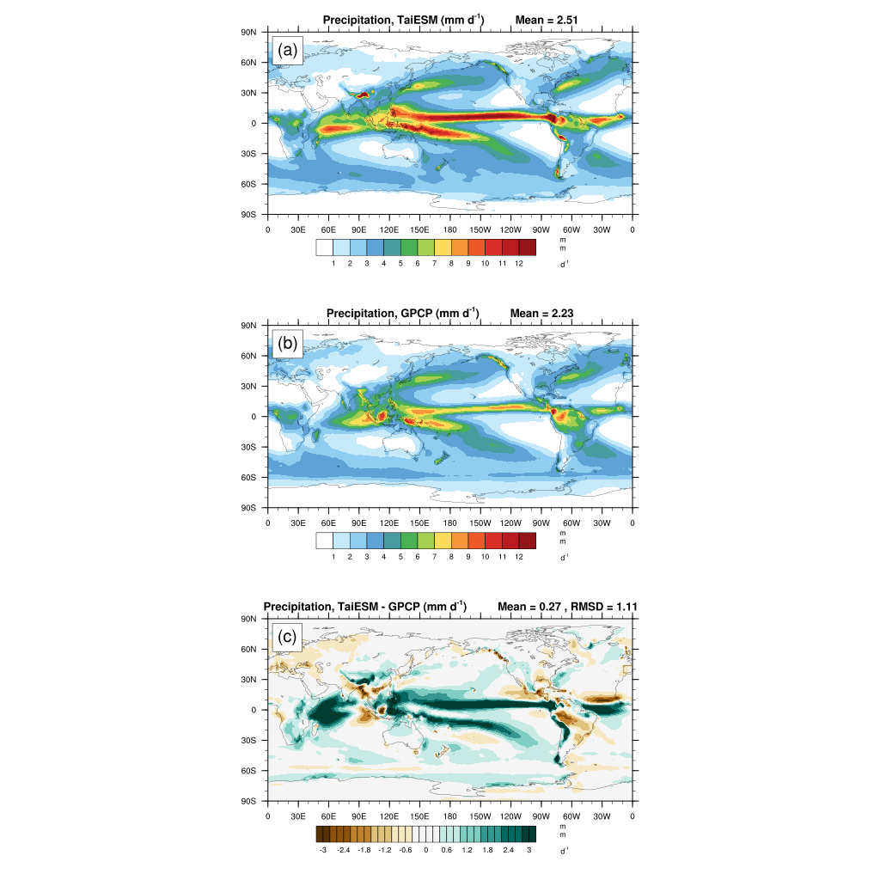
Precipitation: The Double ITCZ Problem
Critical Tropical Bias
Double ITCZ: Spurious SH rain belt (~5-10°S) with >4 mm/day excess
Mechanism: Equatorial cold tongue creates false SST gradient
Note: Common bias in most CMIP models
(a) TaiESM | (b) GPCP | (c) Bias | Units: mm/day

Slide 14

Key Findings: Model Strengths
What TaiESM-TIMCOM Does Well
Strong performance in fundamental climate system representation
Spatial Patterns
Post-1950 Trends
Captures large-scale SST distribution and tropical warm pool
Excellent agreement validates climate sensitivity
Arctic Performance
Ocean Heat Uptake
Realistic sea ice extent and variability
VAT trend correctly simulates heat storage
Foundation for Future Climate Projections

Slide 15
Key Findings: Systematic Biases
Priority Development Areas
1
Antarctic Sea Ice Trend Wrong
Model stable while observations decline
2
Southern Ocean SST +3 to +5°C
Warm bias from insufficient clouds
3
North Atlantic Cold Bias -2 to -4°C
Weak AMOC reduces heat transport
4
Double ITCZ Problem
Spurious tropical rain belt affects circulation

Slide 16


Conclusions & Future Directions
Development Priorities
Overall Assessment
Southern Ocean cloud-radiation coupling
TaiESM-TIMCOM demonstrates promising capability for climate simulation with realistic post-1950 warming trends and fundamental spatial patterns.
AMOC strength tuning
Aerosol-cloud interactions
Tropical convection schemes
Higher resolution for coasts
Scientific Significance
Post-1950 warming credibility provides confidence for future projections. Bias identification guides targeted improvements rather than wholesale redesign.

